Slide 1
Balkan Wars 1912-1913
There were two wars in the Balkans, fought in 1912 and 1913. The first one was between the Balkan states and the Ottoman Empire. The second was between the Balkan states themselves as they fought over the spoils of the first war.

Slide 2
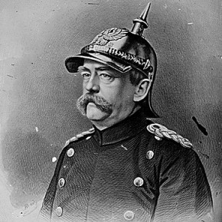
The Balkans
In the 1880s, German Chancellor Otto von Bismarck said that “some damn foolish thing in the Balkans” would start the next big war in Europe.

Slide 3
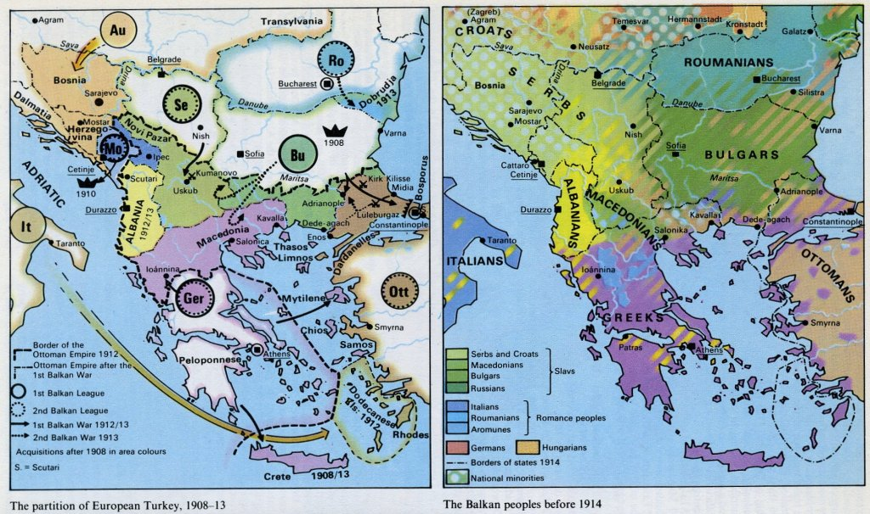
Ethnic Map of Balkans
The Balkans contained a dizzying number of diverse ethnicities, many of whom lived side-by-side, making the process of creating stable state borders almost impossible.

Slide 4
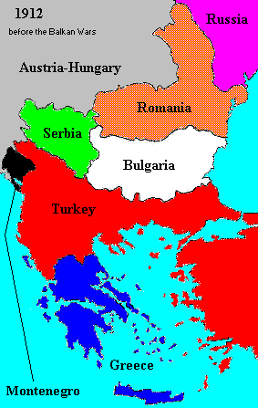
Political Map of the Balkans
The Balkans also featured an unstable mix of a declining Ottoman Empire, a resurgent Russia, and an Austria-Hungary that increasingly saw the Balkan states as rivals.

Slide 5
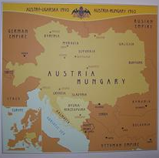
Annexation of Bosnia-Herzegovina by Austria-Hungary in 1908
Believing that the Ottoman Empire was close to collapse, Austria-Hungary acted independently and annexed the region of Bosnia-Herzegovina in 1908. Neighboring Serbia was deeply concerned by the events and asked for Russian support, although the Russians decided not to get directly involved. Serbia was concerned about growing Austria-Hungarian influence in the Balkans. As Ottoman (Turkish) control in the Balkans diminished, both Austria-Hungary and Russia sought to gain influence in the area.

Slide 6
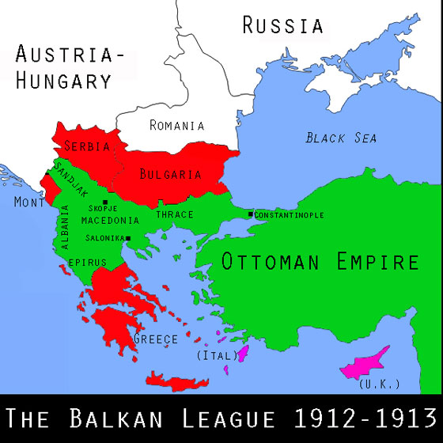
The First Balkan War
“Balkans for the Balkan Nations” was a guiding principle for the nationalist movements. Encouraged by Russia, in 1912 the Balkan League was formed. Bulgaria, Serbia, Greece, and Montenegro created a series of alliances and military agreements to free the Balkan powers from Ottoman influence and power.

Slide 7
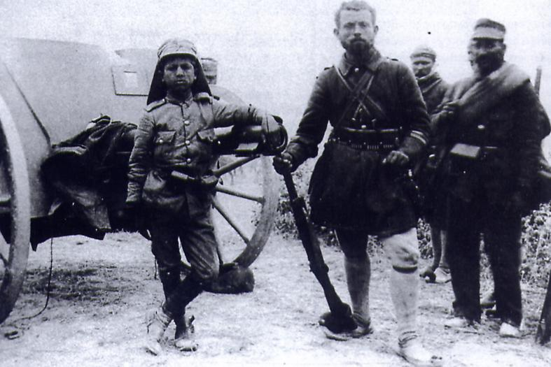
The First Balkan War, October 1912
Following Italy’s attack on the Ottoman Empire and acquisition of Tripoli in 1911, and in light of concerns about Austria-Hungary’s increasing control over the regions (e.g. Bosnia-Herzegovina), the members of the Balkan League, led by Montenegro, declared war on the Ottoman Empire. While successful in their campaign, the peace treaty organized by the European powers frustrated the members of the Balkan League and also created rivalries between them. The treaty, negotiated in London, led to rivalry and subsequent conflict between them. The terms of that treaty included the creation of Albania, which angered the Serbs. The treaty also resulted in increased rivalry between Balkan League members over how to share the territory the Ottoman empire had surrendered.

Slide 8
The Second Balkan War, 1913
Frustrated with the terms of the Treaty of London and the resulting increased rivalry over the Balkan lands the Turks had given up, Bulgaria (with the support of Austria-Hungary) attacked Serbia and Greece over their claims to Macedonia. Romania and Turkey, seeing a chance to gain back some of the land they had just lost, declared war on Bulgaria. The Second Balkan War thus began. The wars and the treaties left festering wounds in the Balkans.
Although the Balkan Wars had been bloody, the great powers had eventually worked together to end them. As a result, they did not spread beyond the Balkans and did not draw the great powers into them. As a result, most people in Europe believed that the system had worked and that even if there might be more violence in the Balkans, that violence could be contained.

Slide 9
Results of the Balkan Wars
The wars created a much larger and more powerful Serbia, which seemed threatening to many people in Austria-Hungary. It also made the Ottoman Empire seem to be, in the word of the time, “the sick man” of Europe. Most of all, the wars made the Balkans even more unstable, seemingly adding weight to Bismarck’s prophecy.

